Slide 1
EE4007 - OPTICAL ELECTRONICS
February 2010
© Alan P. Morrison
Lecture 8 - Optical fibre types and construction

Slide 2
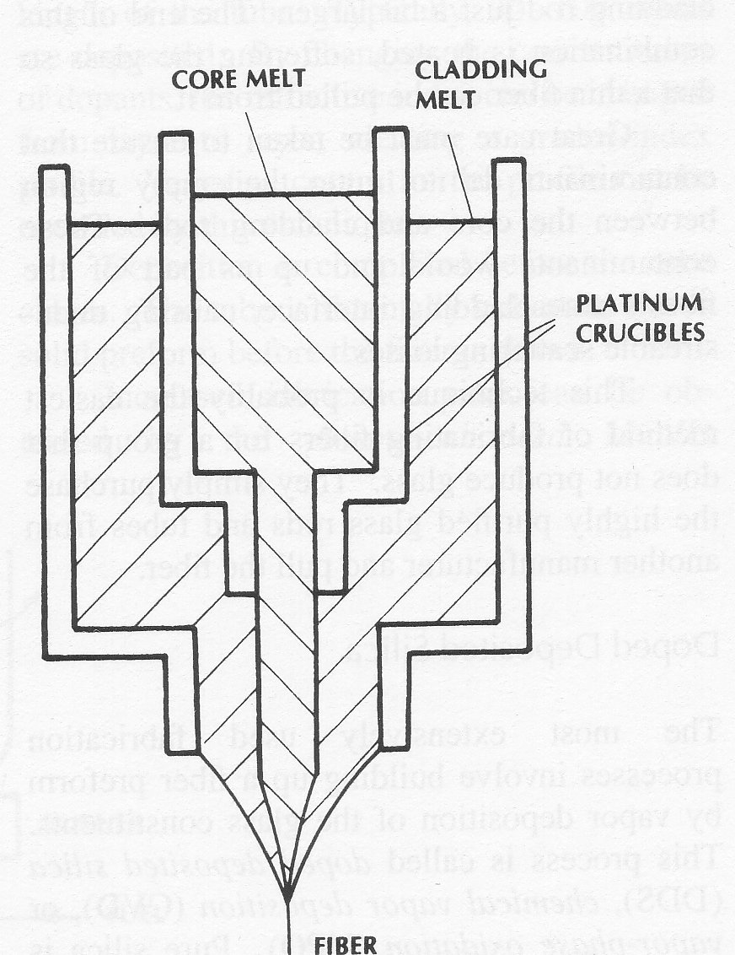
CONSTRUCTION OF OPTICAL FIBRES
February 2010
Double crucible method:
  molten core glass in inner vessel, molten cladding glass in outer vessel
  Both come together at base of outer container
  molten mixture pulled into a fibre
  can also be used to form GRIN fibres by allowing the glasses to interdiffuse after they come together
© Alan P. Morrison

Slide 3
CONSTRUCTION OF OPTICAL FIBRES
February 2010
Rod in tube
  rod of core glass placed inside rod of cladding glass
  end of combination heated, allowing a thin fibre to be pulled from the end
  care needs to be exercised to ensure that contaminants don’t enter the region between the core and cladding
  easiest method to produce fibres, for groups that do not produce glass
Doped deposited silica
  build up fibre preform by vapour deposition of glass constituents
© Alan P. Morrison

Slide 4
CONSTRUCTION OF OPTICAL FIBRES
February 2010
  Process called: doped deposited silica (DDS), chemical vapour deposition (CVD) or vapour-phase oxidation (VPO).
  Dopants can be added to vary refractive index as required
  resulting cylindrical preform has the desired refractive index variation, but its cross sectional area is many times that of the finished fibre (typically 1m long, 2cm diameter)
  continuous fibres of several kilometres can be drawn from preforms of this size
  Examples of three DDS processes include: external deposition, axial deposition and internal deposition
© Alan P. Morrison

Slide 5
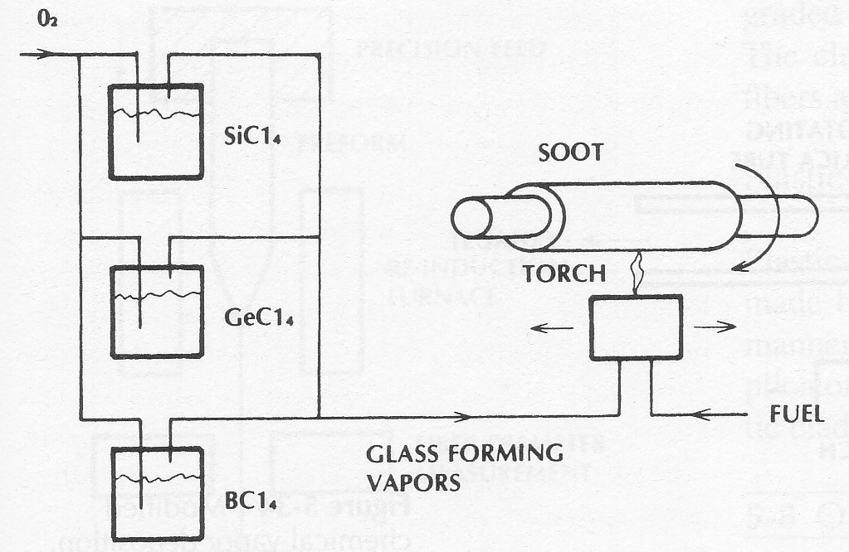
CONSTRUCTION OF OPTICAL FIBRES
February 2010
External deposition
Flame hydrolysis
material vapours oxidised in flame
torch moves laterally => deposits glass particles as soot on rotating bait or mandrel
after deposition => material sintered and bait removed
© Alan P. Morrison
Resulting tube is thermally collapsed to form solid preform.

Slide 6
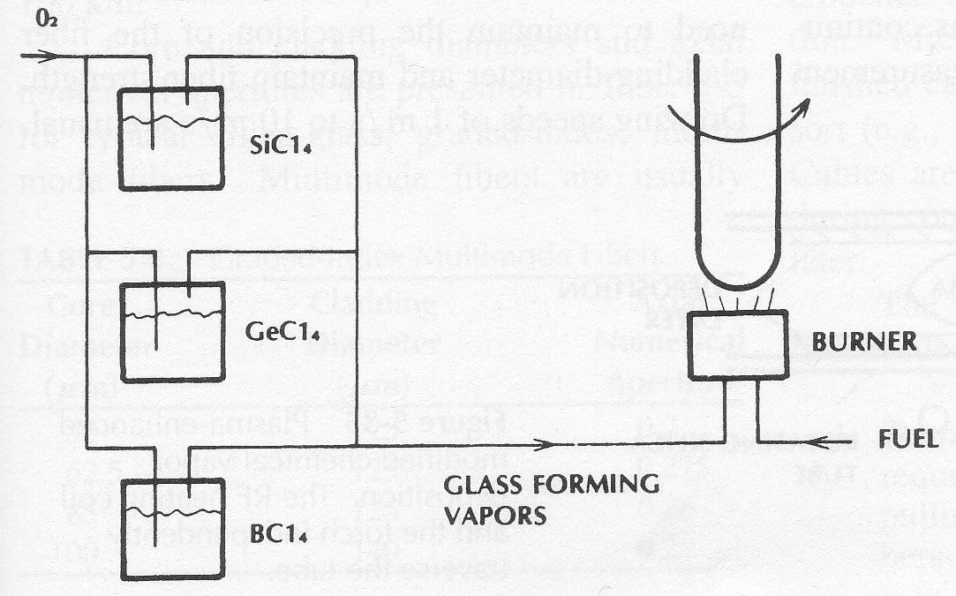
CONSTRUCTION OF OPTICAL FIBRES
February 2010
© Alan P. Morrison
Axial deposition: another form of external deposition, rotating bait is vertical and is withdrawn as the preform builds up.
Very long core preform can be constructed in this manner.

Slide 7
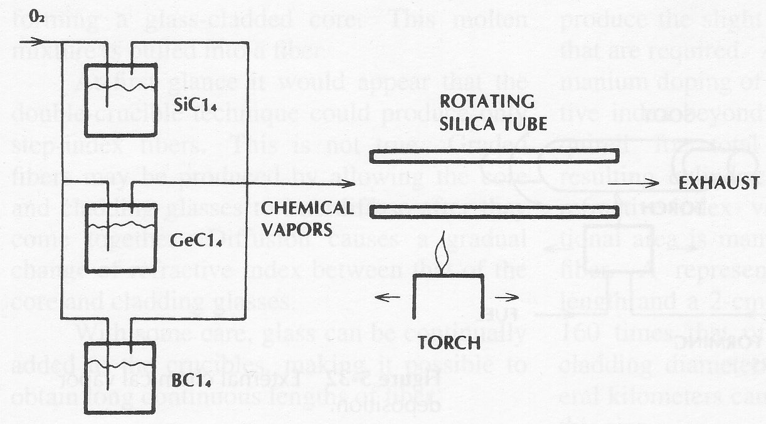
CONSTRUCTION OF OPTICAL FIBRES
February 2010
Internal deposition
© Alan P. Morrison

Slide 8
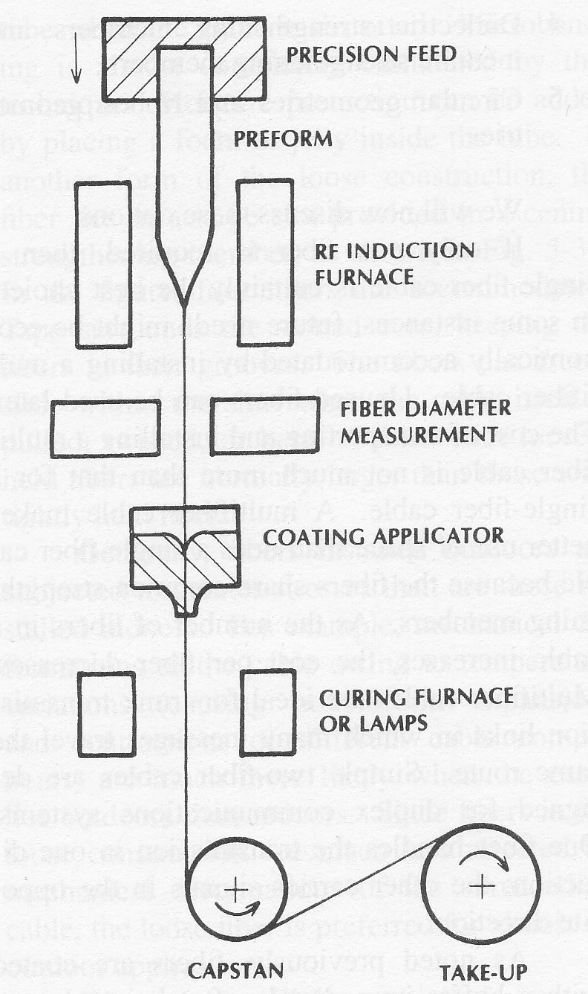
CONSTRUCTION OF OPTICAL FIBRES
February 2010
Fibre drawing:
© Alan P. Morrison

Slide 9
CONSTRUCTION OF OPTICAL FIBRES
February 2010
Appropriate coating materials are:
    kynar, epoxy, silicone RTV, and UV-cured resin
    coating needed to protect fibre from moisture and abrasion
Fast pulling rate is desirable (economic reasons)
  speed limited by need to maintain precision of fibre cladding diameter and maintain fibre strength
  1 - 10 m/s are usual drawing speeds
Cladding tolerances are within 1μm for 125μm fibres
© Alan P. Morrison

Slide 10
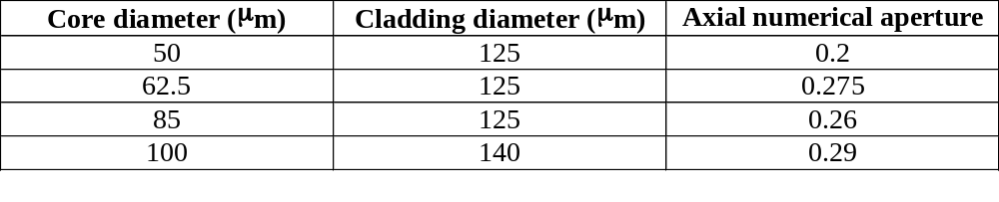
CONSTRUCTION OF OPTICAL FIBRES
February 2010
Typical silica glass, GRIN multimode fibres:
© Alan P. Morrison

Slide 11
OPTIC FIBRE CABLES
February 2010
Amount of protection a fibre needs varies from application to application
Cabling should improve the mechanical characteristics of a fibre without causing deterioration of its optical properties
Types of strengthening and protection needed include:
  tensile strength: must be able to support weight of cable, when hung vertically or between poles
  crush resistance: must survive being stepped on or run over by vehicles
  protection from excess bending: sharp bends cause radiation loss and possible breaks in the fibre
  abrasion protection: small defects caused by abrasion can propagate through the glass and increase the loss significantly
© Alan P. Morrison

Slide 12
OPTIC FIBRE CABLES
February 2010
  Vibration isolation: vibration will increase fibre losses, cables are designed to cushion the fibre, damping out excessive motion
  moisture and chemical protection: moisture and chemicals degrade glass fibres after prolonged exposure.
In addition to the above properties , good fibre cables are light, small, flexible, flame retardant, rodent resistant and temperature insensitive
© Alan P. Morrison

Slide 13
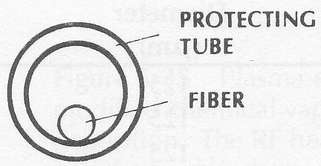
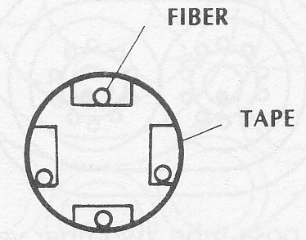
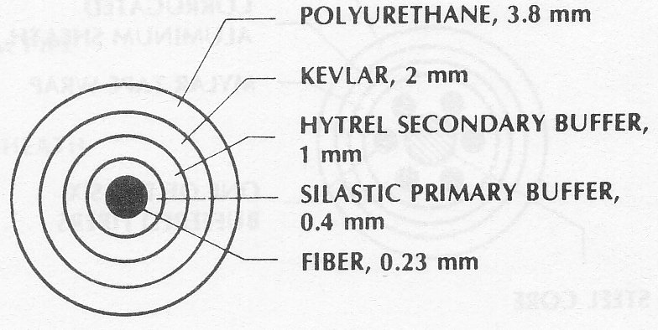
OPTIC FIBRE CABLE TYPES
Loose tube construction
February 2010
Loose fibre, slotted construction
© Alan P. Morrison
Light duty, tight buffer cable
(Siecor Corporation)

Slide 14
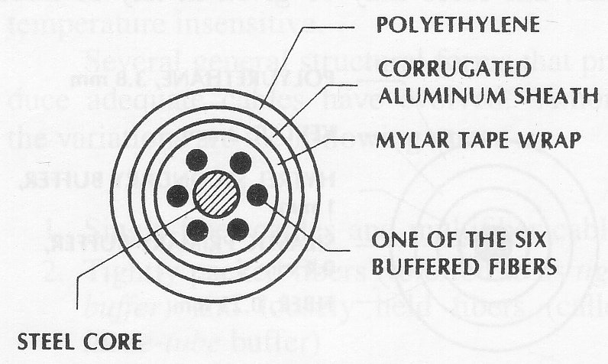
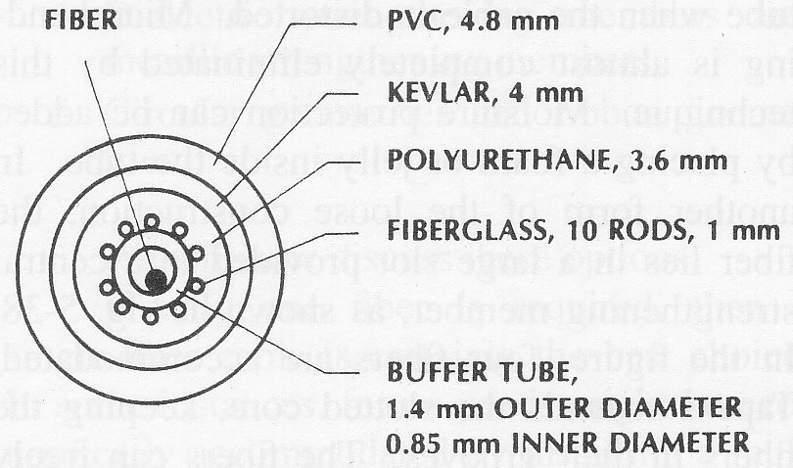
OPTIC FIBRE CABLE TYPES
February 2010
Multifibre cable with central
strengthening member and armoured
sheath
© Alan P. Morrison
Loose tube cable

Slide 15
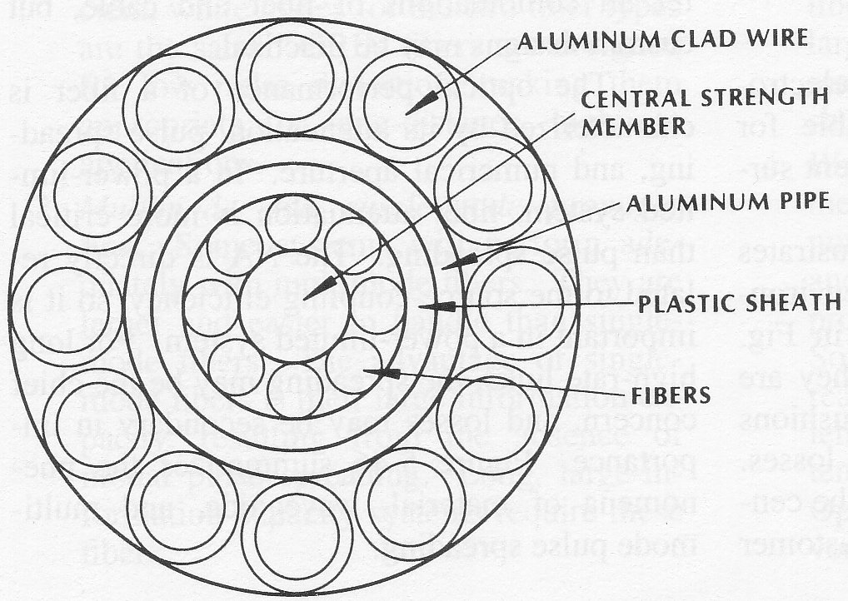
OPTIC FIBRE CABLE TYPES
February 2010
© Alan P. Morrison
Fibre optic overhead power ground wire

Slide 16
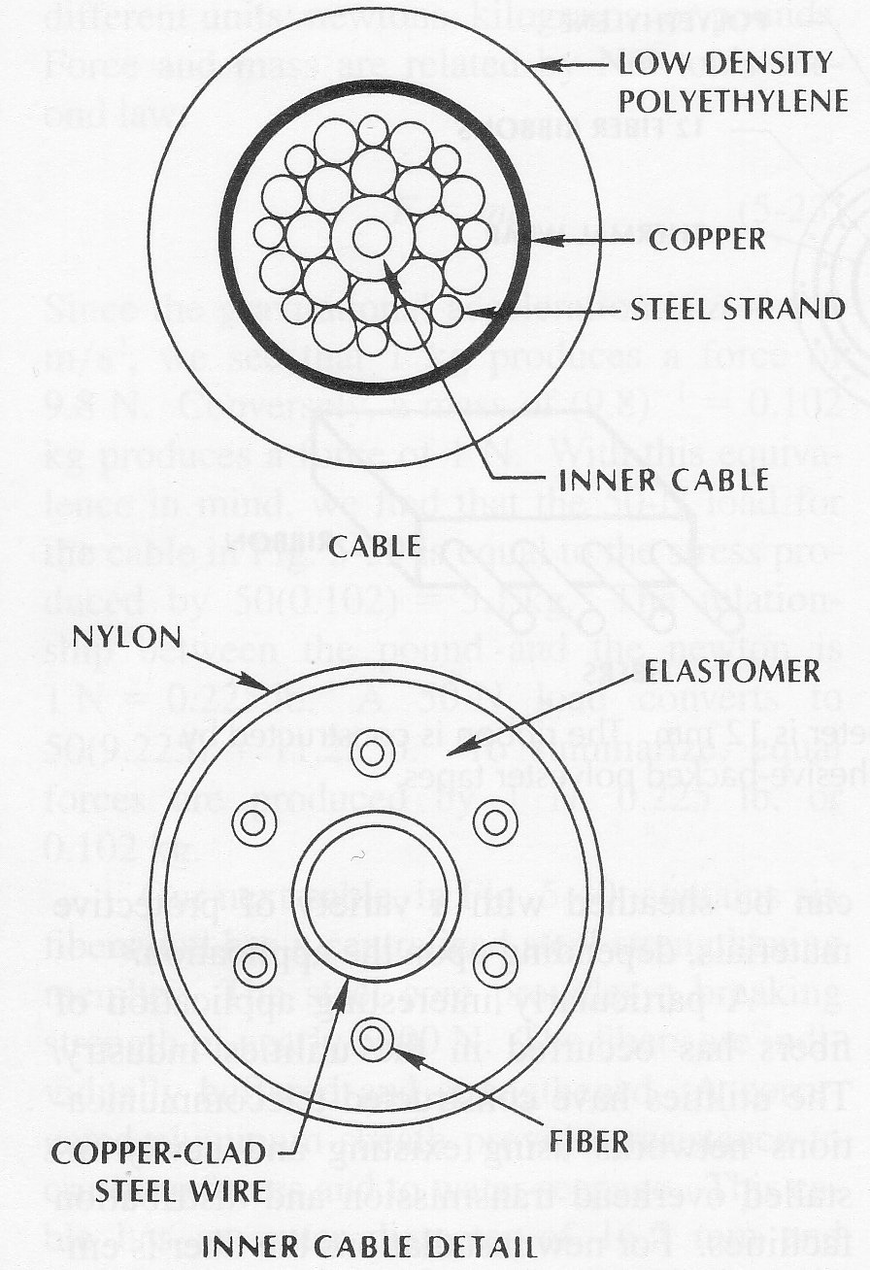
OPTIC FIBRE CABLE TYPES
February 2010
Undersea fibre cable.
© Alan P. Morrison

Slide 17
OPTIC FIBRE CABLES
February 2010
Multifibre cable makes better use of space, because the fibres share strengthening members
As number of fibres per cable increases, the cost per fibre decreases
In loose-tube construction, moisture protection is accomplished by adding foam or jelly inside the tube
loose fibre construction is preferred in outdoor applications because of reduced mechanical stresses
steel wires and textile fibres (Kevlar) are most popular strengthening members
Light duty cables are completed by surrounding Kevlar braiding with outer jacket
© Alan P. Morrison

Slide 18
OPTIC FIBRE CABLES
February 2010
  Jacket provides cut and abrasion resistance
  materials such as polyurethane, polyethylene, PVC and hytrel have been successfully employed in commercial cables
Fibre immunity to electromagnetic interference makes it suitable for installation in the noisy environment surrounding power transmission lines
Foregoing discussion illustrates only a small portion of the cables available.
© Alan P. Morrison

Slide 19
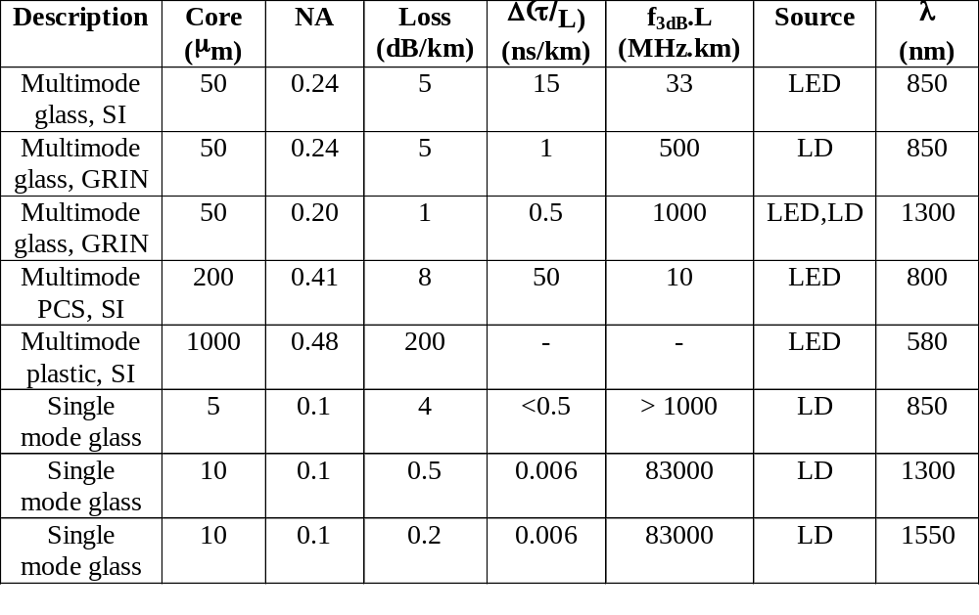
REPRESENTATIVE CHARACTERISTICS OF COMMERCIAL FIBRES
February 2010
© Alan P. Morrison

